Slide 1
Autism…
What a PARE Needs to Know
PARE Business Meeting
December 1, 2015
St. Agnes Church, Nashville

Slide 2
Beatitudes for Friends of People with Disabilities
Blessed are you who take the time to listen to difficult speech, for you help me to know that if I persevere I can be understood.
Blessed are you who never bid me to “hurry up” and take my tasks from me and do them for me, for I often need time rather than help.
Blessed are you who stand beside me as I enter new and untried ventures, for my failures will be outweighed by the times I surprise myself and you.
Blessed are you who asked for my help, for my greatest need is to be needed.
Blessed are you who understand that it is difficult for me to put my thoughts into words.
Blessed are you who, with a smile, encourage me to try once more.
Blessed are you who never remind me that today I asked the same question two times.
Blessed are you who respect me and love me as I am, and not like you wish I were.
Amen

Slide 3
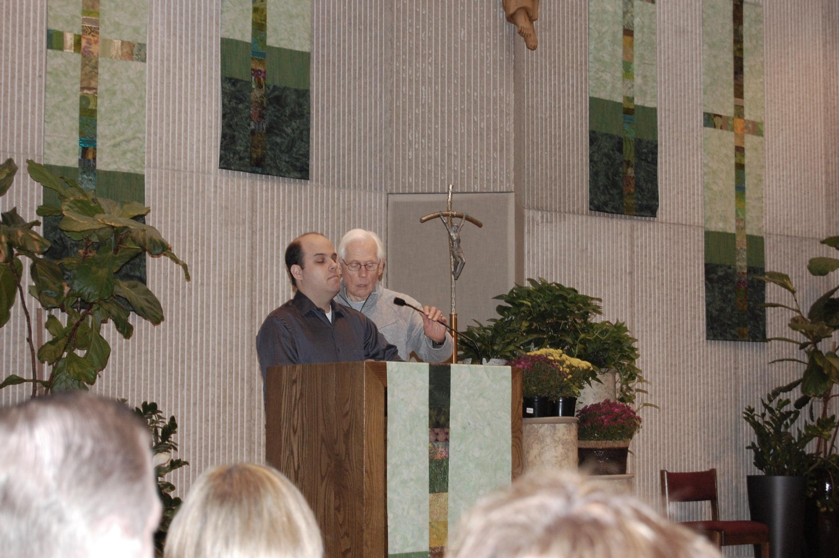
“All persons with disabilities have the capacity to proclaim the Gospel and to be living witnesses to its truth within the community of faith and offer valuable gifts. Their involvement enriches every aspect of Christian life. They are not just the recipients of catechesis- they are also it’s agents.” National Directory of Catechesis 49

Slide 4
A Few Facts
One person in 45 is born with autism (per recent report from CDC) *
There is no definitive cause known yet

Slide 5

Busting Some Myths
Autism is…
Autism is not…
A disorder of the brain’s ability to process information
A developmental disability that affects social, behavioral and communication skills.
A disorder that causes variable functioning.
      How to Welcome, Include and Catechize Children with Autism and Other Special Needs by Lawrence R. Sutton, PH.D.
A psychiatric disorder or mental illness
A phase
A result of child-rearing, stress in the home, evil spirits, or God’s punishment

Slide 6

Gifts and Talents
Autism affects each person differently.
People with autism are often very good at attention to fine detail, and often have the capacity for extraordinary focus.
In subjects of particular interest they can be a veritable encyclopedia of knowledge!

Slide 7
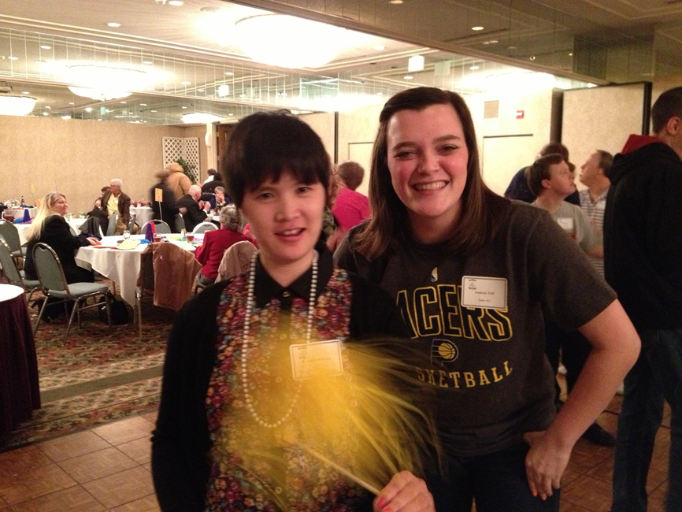
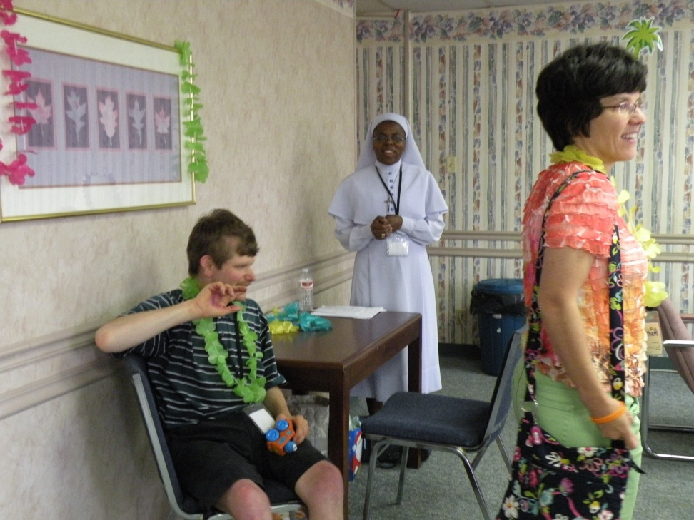
“Stimming”

Slide 8
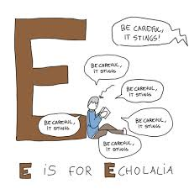
“Echolalia”

Slide 9
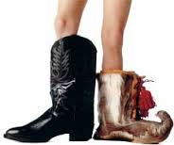
Theory of Mind…
People with autism often struggle to take another’s perspective…
And might need some help knowing what to do socially.

Slide 10
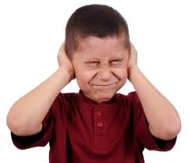
Disordered Sensory Perception
Hyper sensitive ‘senses’
  Brain cannot filter all the input
Visually oriented
  Difficulty filtering visual stimulus.
  Can affect vestibular and proprioceptive senses.
The key here is to be aware, and limit and possibly adapt sensory input wherever possible.
Notes:
Headphones, lamp, or natural light tubes can help with sound and light, sunglasses/tinted glasses, even a tinted transparency placed over reading material to help reduce contrast when reading. Positioning smells, and room temperature are two things to be aware of as well.

Slide 11
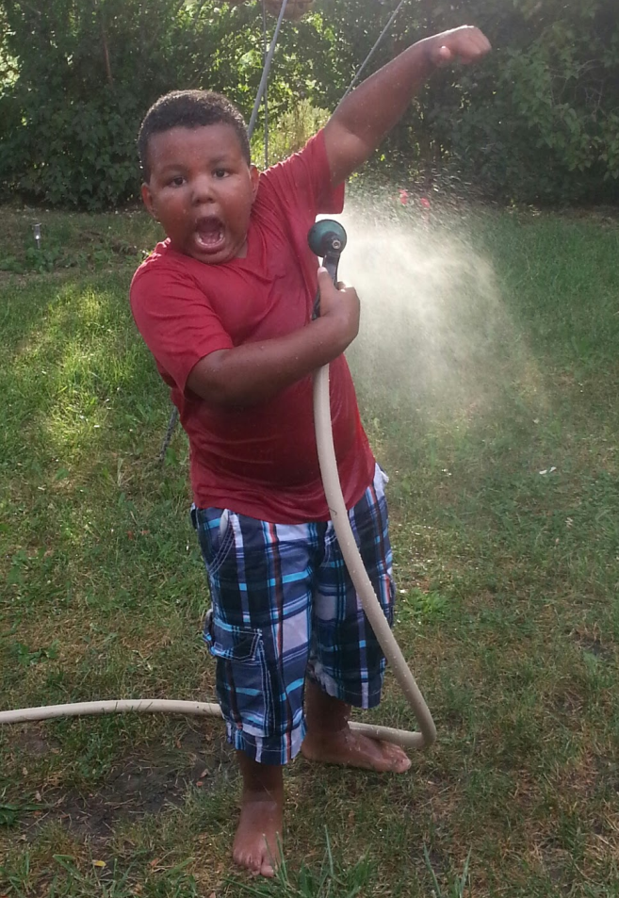
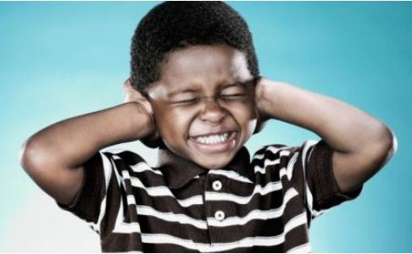
Not All Are the Same…
Sensory avoiding
Sensory seeking

Slide 12
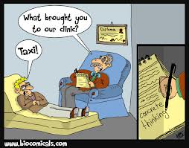
Some Things to Keep in Mind: language
Language is interpreted very literally
Receptive and expressive language is difficult
offer only real choices
concrete, specific and positive language is most effective
Notes:
You can be very creative with choices, and they also help avoid a power struggle: “It is time to go to bed” has lots of choices: “Are you going to wear your red or blue pajamas?”, “would you like me to carry you or to walk like a robot” “Are you going to brush your teeth or wash your face first” to name a few.

Slide 13
What Can I Do?
Realize that you are a model!
Relax when you are communicating with parents or individuals.
Work on recognizing and removing obvious barriers.

Slide 14
What Can I Do?
Gather Information:
  student, parents/caretaker, previous catechists
Maintain open communication

Slide 15
Management and Discipline
Positive Reinforcement- Praise!
Reinforce good behavior in meaningful ways
Establish negative consequences for repeated or extreme inappropriate behavior
Separate the behavior from the child

Slide 16
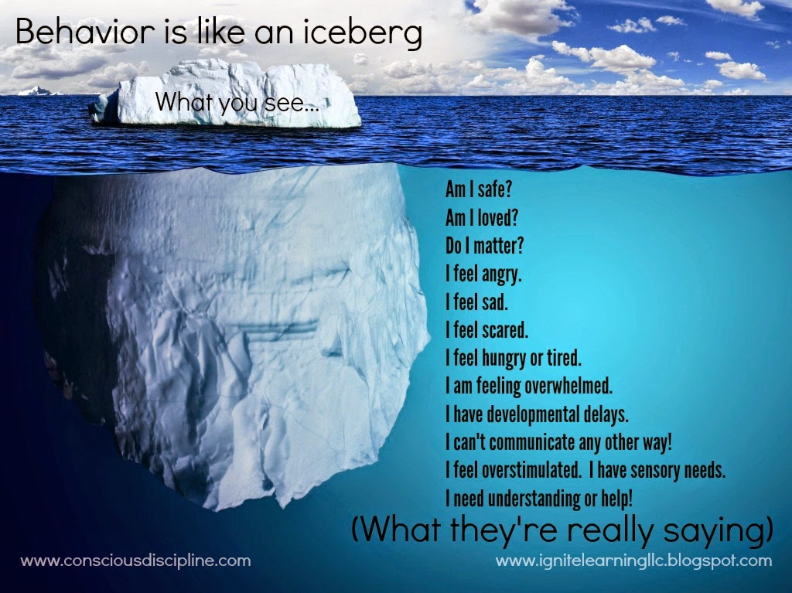

Slide 17

Some Tips for Catechists
Quiet and uncluttered environment
Structure and consistency
Advance notice
Alternate activities
Plan for waiting times

Slide 18

Know the Student

Slide 19
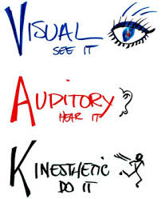
Use Different Learning Modalities!

Slide 20
Multiple Intelligences
Grade Level: Junior High
Topic: Sacrament of the Anointing of the Sick
Objective: Students will appreciate the special needs of sick people and the importance of the sacrament of the Anointing of the Sick
  Ask the students to recall a recent experience of being sick (interpersonal, intrapersonal)
  Read a Gospel story about Jesus’ care for the sick (linguistic)
  Invite a health care professional to class to discuss the special circumstances surrounding illness (logical-mathematical, interpersonal)
  Have students make cards or write letters to encourage the sick, and to visit a hospital or extended care facility to sing a few inspirational songs for the residents (spatial, bodily- kinesthetic, musical)
  Combine a science or health lesson with religion class on the theme of physical and spiritual health (logical-mathematical)
  Investigate the origin of the oil used in the sacrament (naturalistic, logical-mathematical)
  cf. Gifts of the Spirit: Multiple Intelligences in Religious Education, by Rev. Ronald Nuzzi pg. 45

Slide 21
Your Turn!
Grade Level: 7 and 8
Topic: “The Paschal Mystery”
Objective: Students will understand that the Paschal Mystery consists of the life, death, resurrection and ascension of Jesus.
  Linguistic:
  Musical:
  Logical-Mathematical:
  Spatial:
  Bodily-Kinesthetic
  Interpersonal:
  Intrapersonal:
  Naturalistic:

