Slide 1
Palliative Care & Hospice Conference
June 26, 2018
Colleen C. Brown, MD
Adult and Pediatric Supportive Care Program
St. Vincent Hospital
Dr. David Mandelbaum, MD
Medical Director, Palliative Care Services
Co-Director, Franciscan VNS Hospice
Franciscan Health

Slide 2
Palliative (Supportive) Care:
Palliative care is an approach that improves the quality of life of patients and their families facing a life-threatening illness, through the prevention and relief of suffering by means of early identification and impeccable assessment and treatment of pain and other problems, including physical, psychosocial and spiritual.
WHO 2010

Slide 3
Why Palliative Care?
To prevent and relieve suffering
Help support the best possible quality of life for patients and families, regardless of stage of disease or need for other therapies.
  Can be offered with curative treatments or as the main focus of care
Both a philosophy of care and an organized, structured system for delivering care.
Includes the goal of enhancing quality of life for patient and family.
Notes:
Psychosocial and spiritual care, Patient-centered care, Optimize function and symptom management; help with decision-making

Slide 4
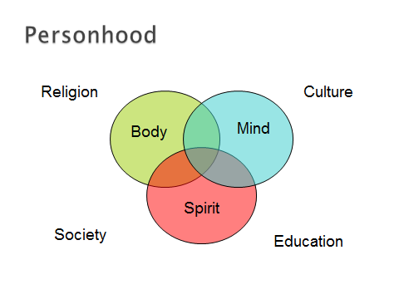

Slide 5
What Brings You Joy?
What Are You Famous For?
WGYLM?
I AM…
What Would You Sacrifice Today for a possible Tomorrow?

Slide 6
Palliative Care:
Affirms Life
  Supports patient/family goals for the future
  Acknowledges hopes for cure or life prolongation as well as peace and dignity at time of death
Does Not Hasten Death
  Not PAS or Euthanasia
May Prolong Life¹
Improves Quality Life
Helps patient and family work toward achievable goals in whatever time they have remaining.
    ¹Temel JS et al. Early Palliative Care for Patients with Metastatic Non–Small- Cell Lung Cancer, N Engl J Med 2010;363:733-42
Notes:
NEJM article in 9/010 was seen as game-changer, since it (unexpectedly) showed pts with stage 4 NSCLC did better when offered both standard therapy and palliative care. On average, PC group lived almost 12 weeks longer, reported better QOL and had less aggressive care at EOL.

Slide 7
Ethical and Religious Directives:
The task of medicine is to care even when it cannot cure.
The innate dignity of human life in all its dimensions is integral to the role of medicine.
The use of life sustaining technology must be viewed in light of the Christian meaning of life, suffering, and death.
Two extremes are avoided: either the insistence on useless or burdensome technology even when a patient may legitimately wish to forgo it and, the withdrawal of technology with the intention of causing death.

Slide 8
ERD 55
Catholic health care institutions offering care to persons in danger of death…should (ensure) that patients be provided with whatever information is necessary to help them understand their condition and have the opportunity to discuss their condition with their family members and care providers.
They should also be offered the appropriate medical information that would make it possible to address the morally legitimate choices available to them.
They should be provided the spiritual support as well as the opportunity to receive the sacraments in order to prepare well for death

Slide 9
ERD 56
A person has a moral obligation to use ordinary or proportionate means of preserving his or her life.
  Proportionate means are those that in the judgment of the patient offer a reasonable hope of benefit and do not entail an excessive burden or impose excessive expense on the family or the community.

Slide 10
ERD 57
A person may forgo extraordinary or disproportionate means of preserving life.
  Disproportionate means are those that in the patient’s judgment do not offer a reasonable hope of benefit or entail an excessive burden, or impose excessive expense on the family or the community.

Slide 11
ERD 59
The free and informed judgment made by a competent adult patient concerning the use or withdrawal of life-sustaining procedures should always be respected and normally complied with, unless it is contrary to Catholic moral teaching

Slide 12
ERD 61
Patients should be kept as free of pain as possible so that they may die comfortably and with dignity, and in the place where they wish to die.
  Medicines capable of alleviating or suppressing pain may be given to a dying person, even if this therapy may indirectly shorten the person’s life so long as the intent is not to hasten death.

Slide 13
Barriers to Hospice & Palliative Care:
Mistaken belief that there is “nothing more” to offer a dying patient
Widespread perception that a patient’s death is due to physician failure
Clinicians worry that palliative care and hospice is tantamount to “giving up”.
  Many believe that patients do not want to talk about death and dying.
Pts/families reluctant to seek or accept palliative care as they equate it with “giving up”
  Often lack understanding of benefits of palliative care and hospice.

Slide 14
To Cure Sometimes…
    To Relieve Often…
      To Comfort Always.

Slide 15
Hospice – Origin and Definition
Term hospice, from same linguistic root as “hospitality”, can be traced back to medieval times when it referred to a place of shelter and rest for weary or ill travelers on a long journey.
Defined as: Team oriented approach to medical care, symptom management, and emotional and spiritual support tailored to the needs of a patient with a terminal illness or injury.
Eligibility for Medicare Benefit: Patient is eligible for hospice care if two MD’s (One should be a Hospice MD) determine the patient has a prognosis of six months or less.

Slide 16
Further Definition of Palliative & Hospice Care
Both Palliative Care and Hospice Care provide symptom management, enhance quality of life and respect patient’s desires and preferences. Hospice care is specifically devoted to End of Life care.
So, ALL Hospice Care is also Palliative Care, but NOT ALL Palliative Care is also Hospice Care.

Slide 17
Terms NOT seen in the definition of Hospice Care
Reduce Care
Withhold Therapy
Euthanasia
Morphine Drip
Death Squad
Take Away Hope

Slide 18
Hospice Care: Where?
The majority of hospice care is provided in the place the patient calls home. This may include not only private residences, but also nursing homes and residential facilities. Hospice care may also be provided in freestanding dedicated hospice facilities and hospitals.

Slide 19
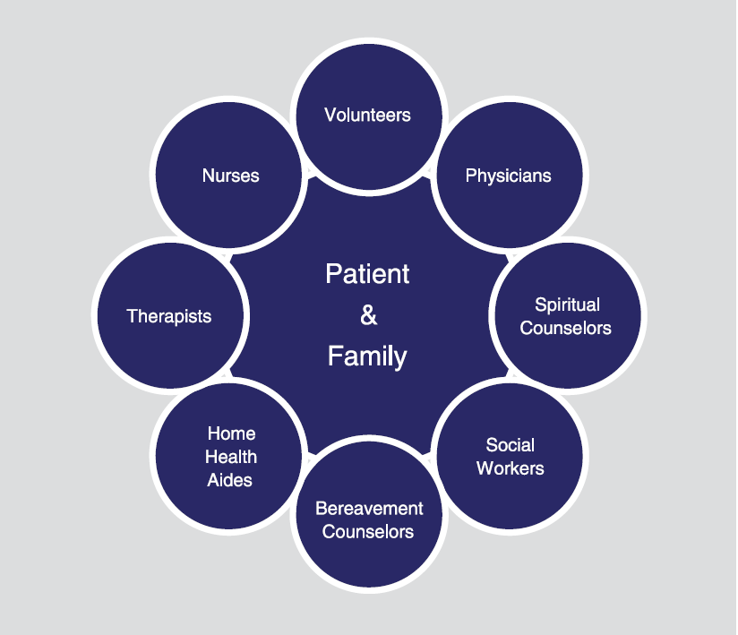
How Hospice Care is Delivered
Hospice Care is truly a team sport
Source: NHPCO Facts & Figures – 2017 Edition

Slide 20
Volunteer Services
U.S. Hospice Movement was founded by Volunteers
Medicare requires volunteers provide at least 5% of all patient care hours
Services provided:
  Spending time with patients and families
  Clerical services and other support
  Other activities including: Fundraising, outreach, education

Slide 21
Hospice Levels of Care
GIP (General Inpatient)
  Approx. 1.5% of pts. nationally
  Uncontrollable symptoms
  Covered by Medicare Benefit
Respite
  Approx. 0.5% of pts. nationally
  Care giver fatigue
  Covered by Medicare Benefit
Routine
  Approx. 98% of pts. nationally
  No other viable options
  Room and Board is NOT covered

Slide 22
Hospice Statistics
1.43 million Medicare beneficiaries were enrolled in hospice in 2016
48% of all Medicare decedents were enrolled in hospice at time of death in 2016
Proportion of Medicare decedents enrolled in hospice varied greatly from state to state
      Highest: Utah, Arizona, Florida, Iowa
      Lowest: Alaska, North Dakota, Wyoming

Slide 23
Hospice Statistics (Continued)
Diagnoses
Cancer 27.2%
Cardiac, Circulatory 18.7%
Dementia 18%
Respiratory 11%
Stroke 9.5%
Other 15.6%
Length of Service
Average 71 days
Median 24 days
Location of Deaths for Hospice Patients
Home 44.6%
Nursing Facility 32.8%
Hospice Facility 14.6%
Acute Care 7.4%

Slide 24

Franciscan St. Francis Hospice House

Slide 25
Advanced Care Planning
Advanced directives-legal documents to ensure future health care choices are documented
Laws often vary by state
Gives every competent adult the right to make their own health care decisions including what treatment to accept, reject or discontinue as well as the right to name someone to make decisions for you

Slide 26
IN Advanced Care Documents:
Appointment of Health Care Representative
Indiana POST Form
Out of Hospital Do Not Resuscitate Declaration
Talking directly to your physician and family
Living Will Declaration
Organ and Tissue donation
Psychiatric Advanced Directives
Power of Attorney
  Typically financial document, though can be both if “Durable Medical Power of Attorney”

Slide 27
IN Health Care Representative:
Legal document that allows you to appoint another person as a representative to make health care decisions on your behalf
Only takes effect if you should be temporarily or permanently unable to make those decisions yourself
It is critical that the decision maker
  Is aware of your wishes
  Acts in your best interest

Slide 28
New Ranking Order for Decision Makers (effective 7/1/2018):
A Judicially appointed health care representative
A spouse; if no spouse, then​
An adult child; if no adult child, then​
A parent; if no parent, then
An adult sibling; if no adult sibling, then​
A grandparent; if no grandparent, then​
An adult grandchild; if no adult grandchild, then​
The nearest other adult relative in the next degree of kinship (think aunts, uncles, nieces, nephews and cousins); if no other adult relative, then​
A friend who is an adult, and ​has maintained regular contact with the individual, and​ is familiar with the individual’s activities, health and religious or moral beliefs​
If no friend, then the individual’s religious superior if the individual is a member of a religious order.

Slide 29
Indiana POST Form:
Law enacted July 1, 2013, updated 2016.
Physician Orders for Scope of Therapy-order set that can follow the patient in any care setting
Appropriate in the following conditions:
  Advanced chronic progressive illness
  Advanced chronic progressive frailty
  Any condition when the patient might be expected to die “in the near future” (i.e. 1-2 years)
  Condition that leaves the patient unable or unlikely to benefit from resuscitation in the event of cardiac or pulmonary failure.
                www.indianapost.org

Slide 30
Do Not Resuscitate/Allow Natural Death
Important to know statistics to make informed decision regarding DNR
Since its invention in 1959, we have not significantly improved outcomes from CPR
In general, survival to discharge for cardiopulmonary arrest is 15%
  Worse when patients are older (>70yo), and/or has advanced disease (cancer, heart or lung disease, frailty)
    Survival is essentially 0 for those patients.

Slide 31

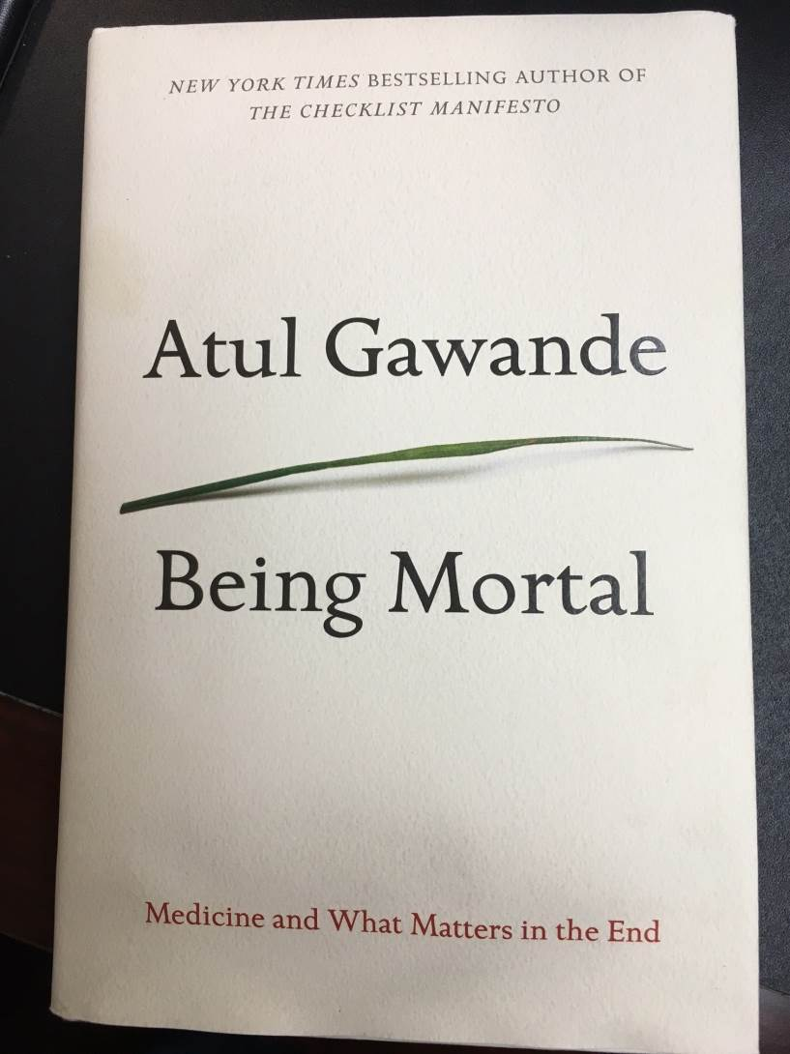
Reading References

Slide 32
References:
    Temel JS et al. Early Palliative Care for Patients with Metastatic Non–Small-Cell Lung Cancer, N Engl J Med 2010;363:733-42
    Cassel EJ. The Nature of Suffering and the Goals of Medicine. New York: Oxford University Press; 1991:32-34.
    Hanks, Cherny et al. Oxford Textbook of Palliative Medicine. New York: Oxford University Press; 2010
    A National Framework and Preferred Practiced for Palliative and Hospice Quality Care. A National Quality Forum (NQF) Consensus Report, www.qualityforum.org/publications/reports. Accessed 4/14/2013.

Slide 33
Comments and Questions?

Slide 34
Parishioner: Casey
33 year old, married, 3 children at your elementary school.
Diagnosed with Melanoma (a very serious skin cancer- can be treated, potentially cured if caught early, however quite lethal if caught late, or after it has spread.
Asked to speak with you about this diagnosis, and its impact.

